Slide 1





Joohyun Kim, Sharath Maddineni, Shantenu Jha Center for Computation and Technology (CCT) Louisiana State University A TeraGrid/Blue Waters Symposium on Data-Intensive Analysis, Analytics, and Informatics, April 14-15, 2011, Pittsburgh, PA

Slide 2
Content
Introduction : Next-Generation DNA Sequencing (NGS) and Its Impact on Life Sciences
Distributed Adaptive Runtime Environment (DARE) Framework: A Solution Built upon SAGA-BigJob
DARE-NGS : Mapping on Scalable Distributed HPC resources
(Emerging Computational Methods in Life Sciences Workshop at HPDC11)

Slide 3
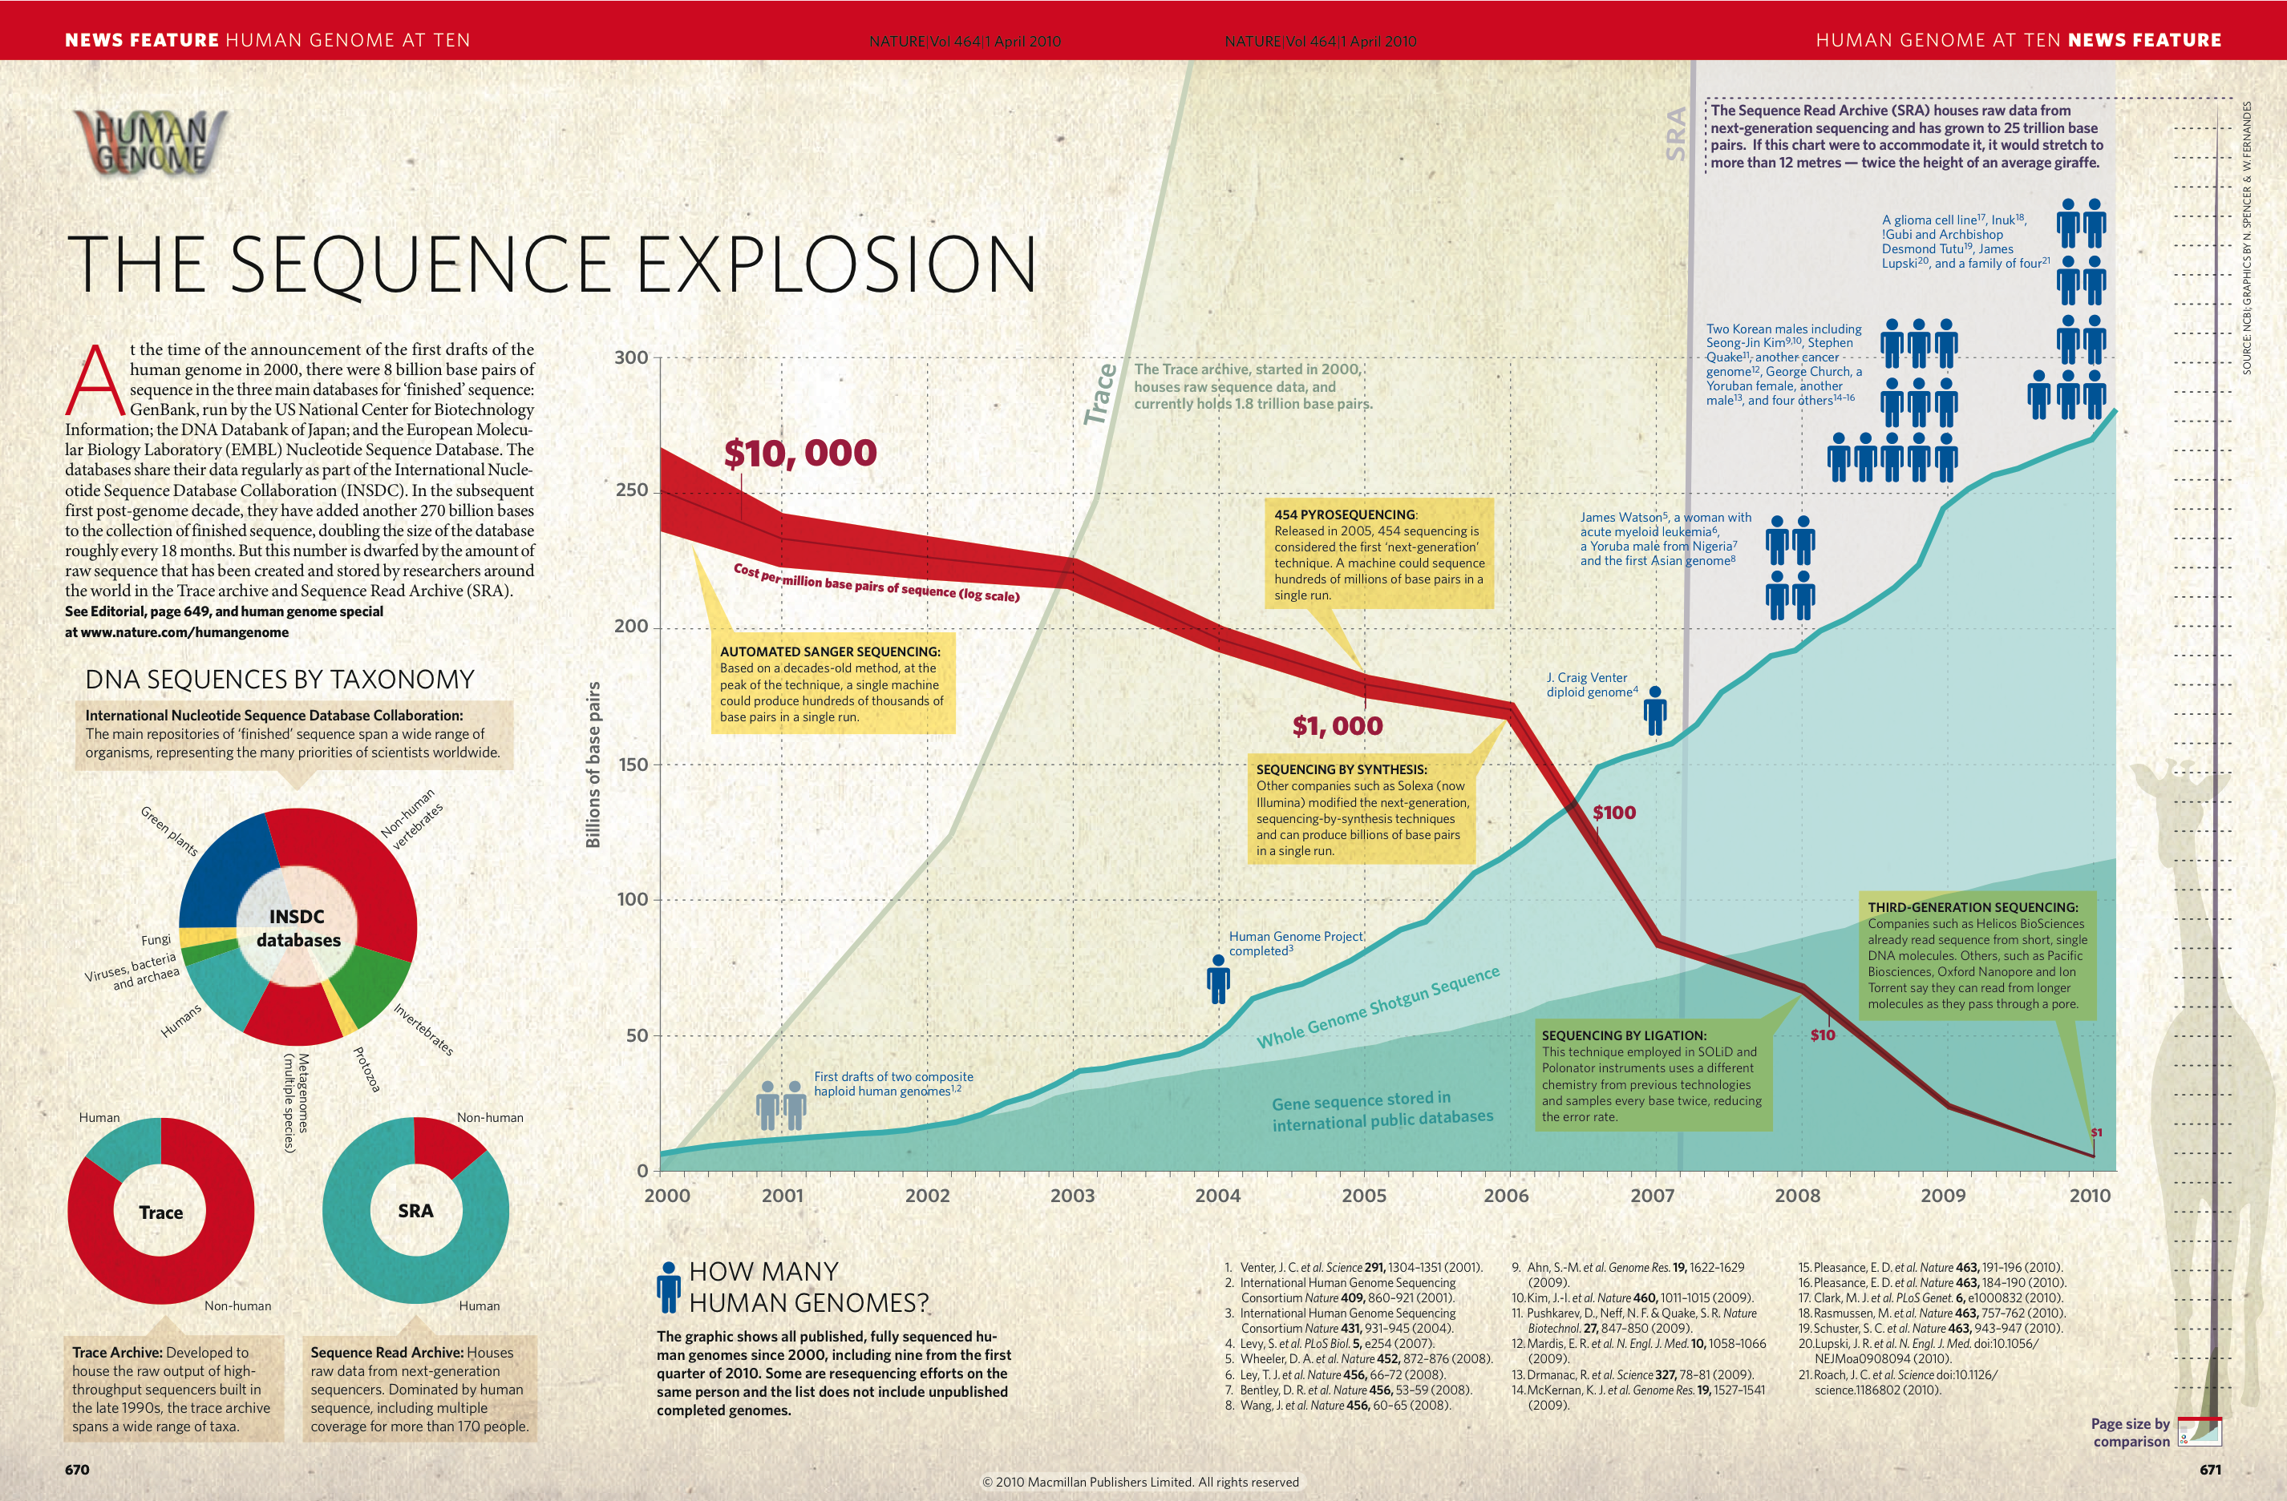
Next-Generation DNA Sequencing (NGS) and Its Impact on Life Sciences
Nature, 464, 670 (2010)

Slide 4
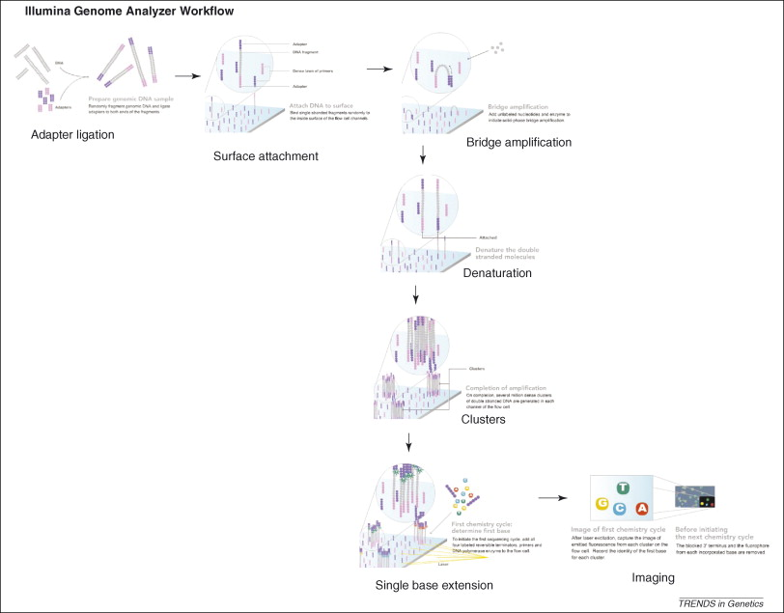
Next-Generation DNA Sequencing (NGS) and Its Impact on Life Sciences
E. R. Mardis, The impact of next-generation sequencing technology on genetics, Trends in Genetics, 24, 133 (2008)
Notes:
SJ: Difficult to see the picture in the lower half

Slide 5
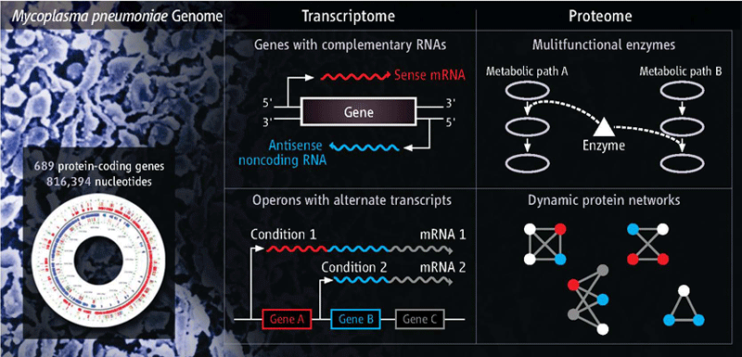
Next-Generation DNA Sequencing (NGS) and Its Impact on Life Sciences
High-throughput Sequencing Techniques and Ever-growing Genomic Data Sets
Dynamic gene expression and regulation mechanism (cell development and differentiation) : infection, immune response, cancer, epigenetics, gene localization, other diseases, ….
Dynamic gene expression and regulation mechanisms (cell development and differentiation) : infection, immune response, cancer, epigenetics, gene localization, other diseases, ….
Data- Intensive Computing
“Excavating the Functional Landscape of Bacterial Cells”
Howard Ochman and Rahul Raghavan, Science, 27 Nov. 2009

Slide 6
Next-Generation DNA Sequencing (NGS) and Its Impact on Life Sciences
High-throughput Sequencing Techniques and Ever-growing Genomic Data Sets
Nature, 467, 1061 (2010)
Notes:
This is getting too long. There will be other people talking about NGS and we will be the last
To talk about NGS, so a lot of this will be covered. We should give no more than 3-5min motivation.

Slide 7
Next-Generation DNA Sequencing (NGS) and Its Impact on Life Sciences
Overview - Computational/Bioinformatics Strategies for Genomic Data Analysis
WGS, CHIP-Seq, RNA-Seq: Billions Short Reads
Mapping
De Novo Assembly
Genome Variation:
SNP, InDel, CNV
Comparative Genomics, Epigenetics
Gene Finding/Identification
Coding Gene
Non-coding RNA
Motif Finding
Whole Genome Analysis (WGS)
Transcriptome Analysis
(RNA-seq, ChIP-seq)
Exome Analysis
Functional Annotation, Pathway Analysis – Cell Development & Differentiation, Host-Pathogen interaction, Biomedical research
Notes:
SJ: Color coding is a bit misleading. Does purple (right sight, lower level) represent analysis? If so, be sure to say so

Slide 8
Next-Generation DNA Sequencing (NGS) and Its Impact on Life Sciences
Genome2Function : (Microbial System)
NGS Sequencing Data
(WGS/RNA-seq/CHIP-seq)
Assembly/Mapping
Whole Genome Sequence
Transcriptome Sequences
Coding Gene Finding/ncRNA Finding/DNA motif Finding/Gene Annotation/variation
Annotated Genes
Identified Genes
Structure Modeling/Structure Database Search
Structure
Docking/Binding Affinity
Function
Notes:
SJ: Something more structured than this is preferable. I still think this is getting too long. There will be other people talking about NGS and we will be the last
To talk about NGS, so a lot of this will be covered. We should give no more than 3-5min motivation.

Slide 9
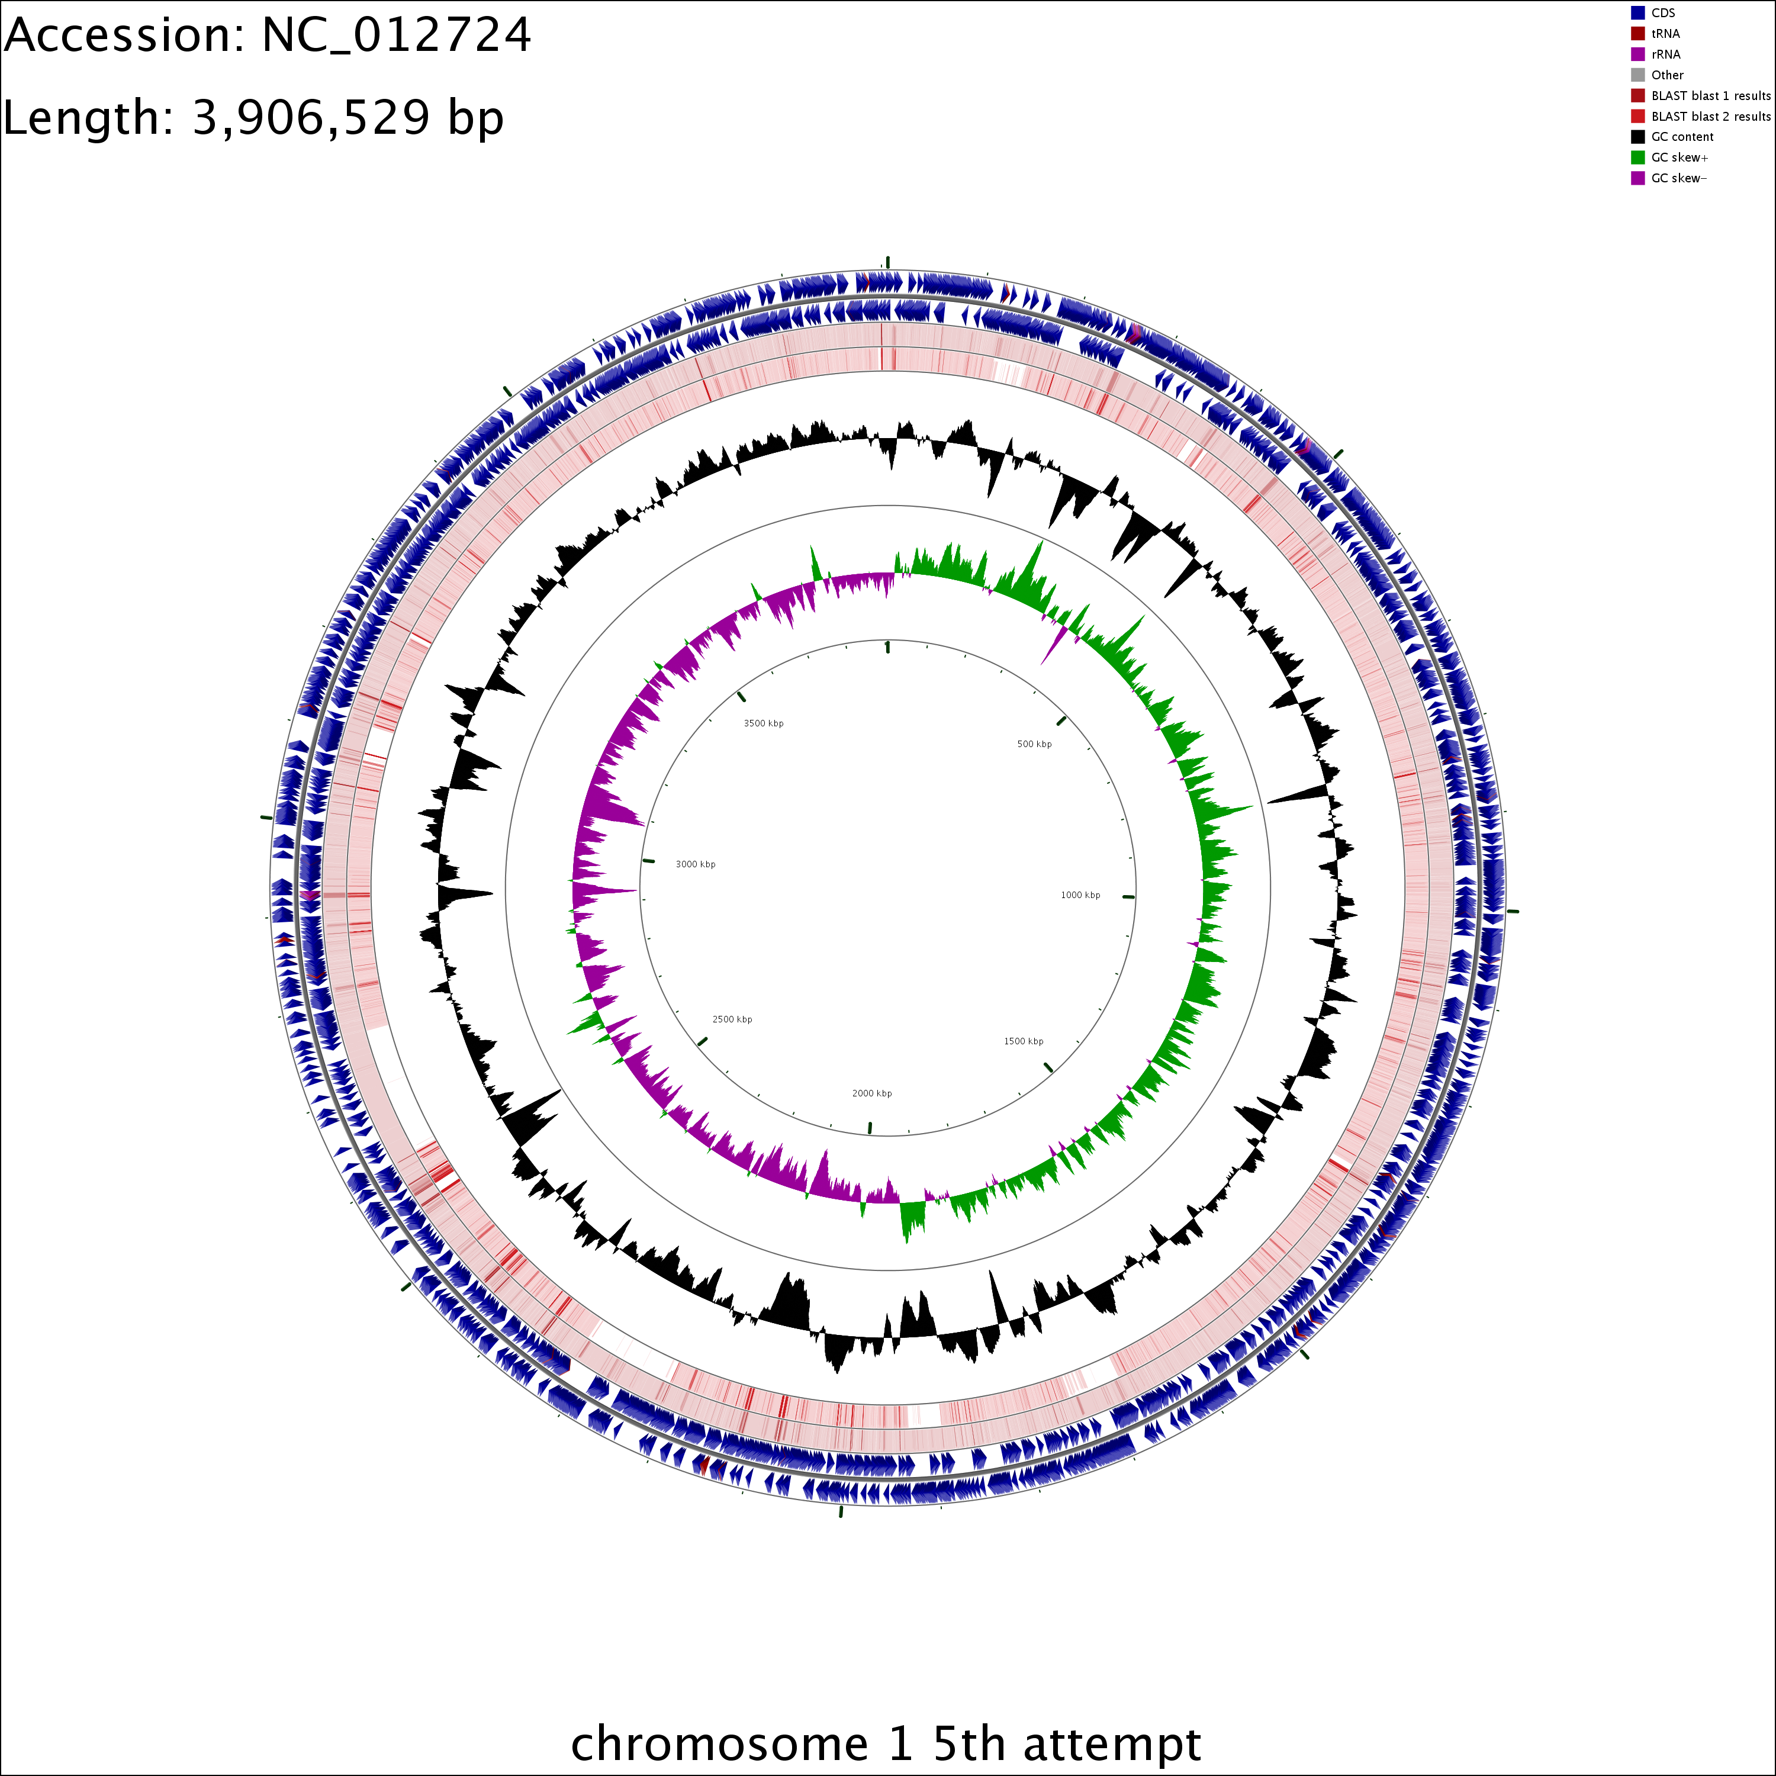
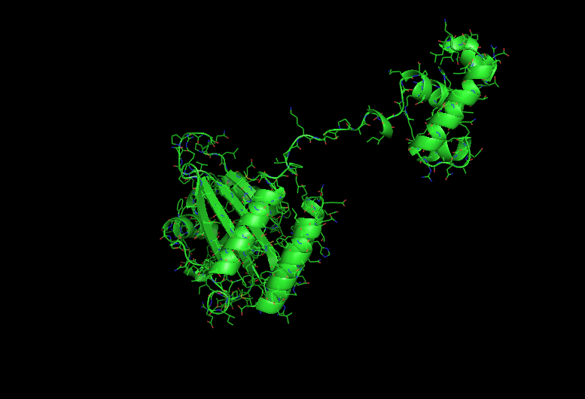
Next-Generation DNA Sequencing (NGS) and Its Impact on Life Sciences
Genome2Function : Burkerholderia Glumae, A Rice Pathogen – A New Era of Structural Bioinformatics
Homology-based 3D modeling of TofR (Virulence Factor Associated Transcription Factor gene)
Mapping Result of NGS Data
Notes:
SJ: Something more structured than this is preferable. I still think this is getting too long. There will be other people talking about NGS and we will be the last
To talk about NGS, so a lot of this will be covered. We should give no more than 3-5min motivation.

Slide 10
Next-Generation DNA Sequencing (NGS) and Its Impact on Life Sciences
Unprecedented novel opportunities for life sciences
High-throughput DNA sequencing
Significant roles of computation (algorithm, methods, implementation, and infrastructure)
Data-intensive computation
Driving paradigm shift in computational biology touting the importance of distributed parallel execution
Notes:
Why is point 4 an impact? Is it not a challenge? I don’t know how we can claim point 5?

Slide 11
Distributed Computing: Solution or Complexity?
(Coarse-grain Level) data set of a genome sequence
(e.g. chromosome)
Chromosomes : Genomic Structure
Multiple sets of Transcriptome : Gene Expression/Regulation
Multiple individuals (or strains) : Genome Variation/Association
Multiple species : Comparative Genomics
And so on (e.g. search public databases with BLAST)
NGS Data Analytics would be greatly
enhanced by Task Level Concurrency
and Distributed Data Infrastructure
Notes:
Good slide. Modified title a bit..

Slide 12
Distributed Computing: Solution or Complexity?
Task Level Concurrency and Scale-Out
Compute System | # of cores | # of tasks | Task Concurrency | Bfast (mapping)
Workstation | 4 | 8 | No | ≈18 h
Ranger | 64 | 4 | Yes | 6.5 h
Ranger | 128 | 8 | Yes | 3.4 h
Ranger | 256 | 16 | Yes | 1.95 h
Case | HPC System | # of cores | Bfast (mapping)
I | QB | 256 | 2.66 h
II | Ranger | 128 | 2.11 h
 | QB | 128
Read Data
(12 GB)
Reference Genome
Single Machine
I
case | Read File Size(GB) | # of Task | Threads/task | Bfast (Mapping)
s1 | 2.4 | 1 | 4 | 2.6
s2 | 1.2 | 2 | 2 | 1.5
s3 | 0.6 | 4 | 1 | 2.5
s4 | 0.6 | 4 | 4 | 1.6
II
Notes:
(JK) Here, upper two tables represent the benefits of task level concurrency and scale-out strategy

Slide 13
Distributed Computing : Solution or Complexity?
Requirement for a solution (IDEAS)
Interoperability: Ability to work across multiple distributed resources
Distributed Scale-Out: The ability to utilize multiple distributed resources concurrently
Extensibility: Support new patterns/abstractions, different programming systems, functionality & Infrastructure
Adaptivity: Response to fluctuations in dynamic resource and availability of dynamic data
Simplicity: Accommodate above distributed concerns at different levels easily…

Slide 14
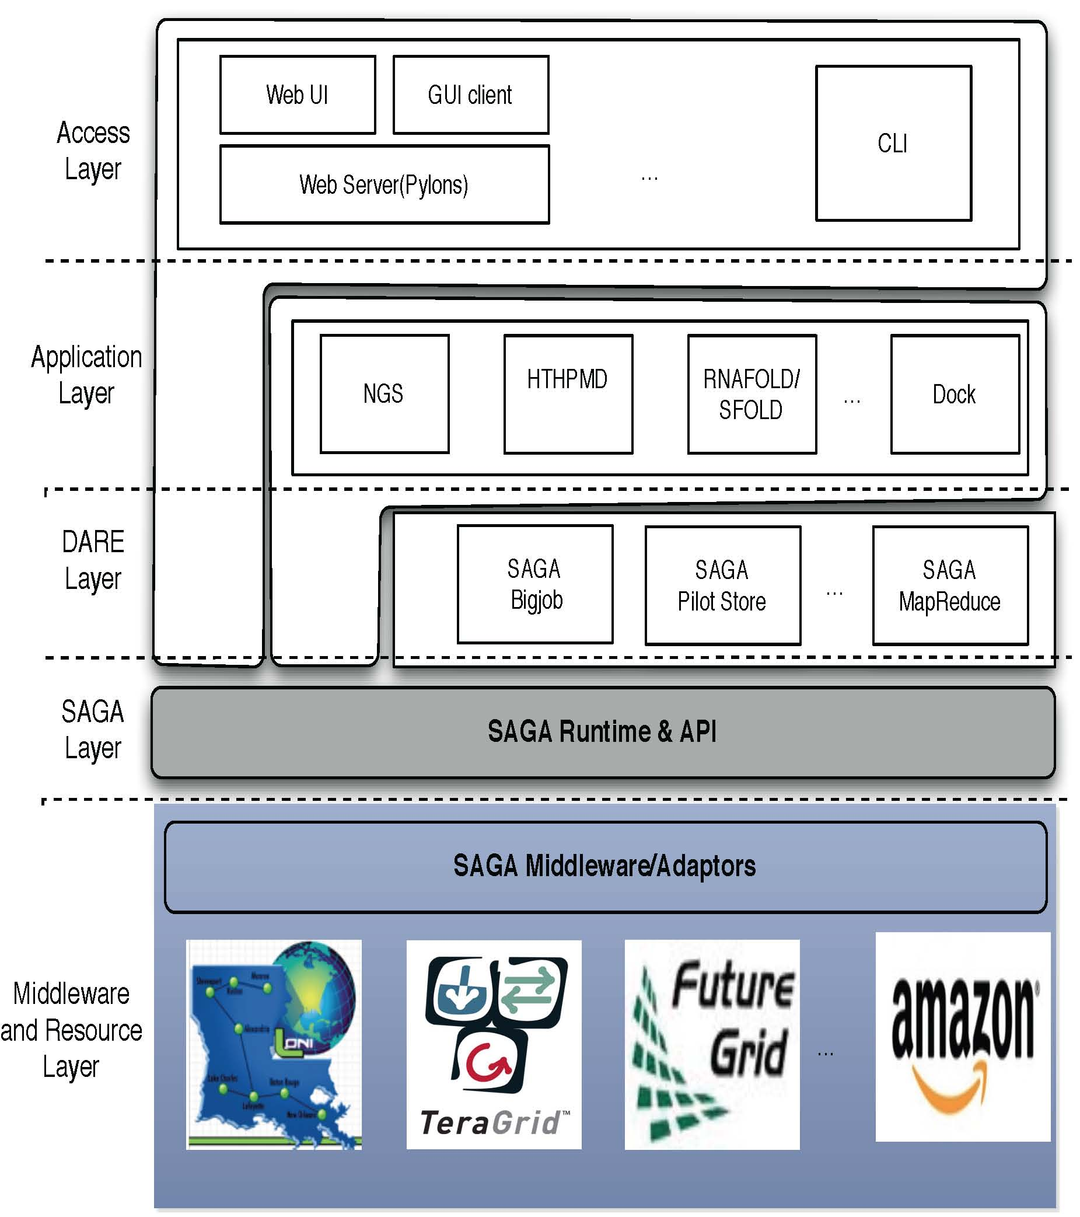
DARE Framework: A Solution Built upon SAGA-BigJob
Notes:
Fixed the diagram.. Please remove next slide if you are OK with this

Slide 15
DARE Framework: A Solution Built upon SAGA-BigJob
SAGA in a Nutshell : saga.cct.lsu.edu
Motivated to develop a programmatic approach that:
Provide general-purpose, basic &common grid functionality for applications and thus hide underlying complexity, varying semantics.
Be building blocks to construct “consistent” higher-levels of functionality and abstractions
Meets the need for a Broad Spectrum of Application:
Simple scripts, Gateways, Smart Applications and Production Grade Tooling, Workflow…
Simple, integrated, stable, uniform and high-level interface
Integrated: Similar semantics & style across
Uniform: Same interface for different distributed systems

Slide 16
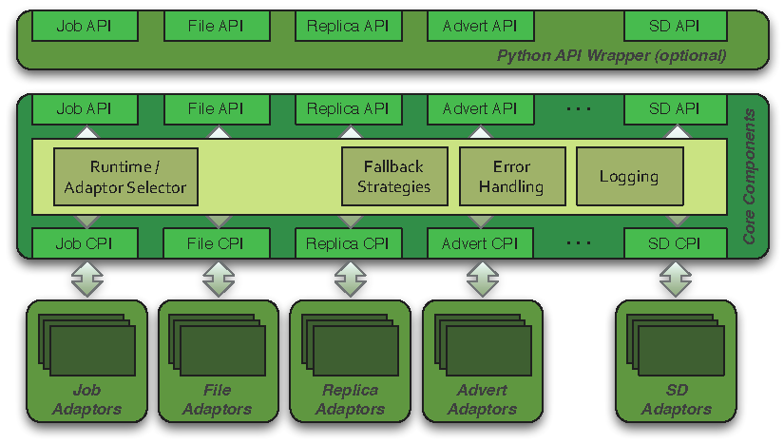
DARE Framework: A Solution Built upon SAGA-BigJob
SAGA Architecture

Slide 17
DARE Framework: A Solution Built upon SAGA-BigJob
SAGA Extensibility
Horizontal Extensibility – API Package
File management, job management, remote procedure calls, replica management, data streaming
Steering, information services, checkpoint…
Vertical Extensibility – Middleware Bindings
Different adaptors for different middleware
Set of ‘local’ adaptors
Extensibility for Optimization and Features
Bulk optimization, modular design

Slide 18
DARE Framework: A Solution Built upon SAGA-BigJob
SAGA Adaptors
Job Adaptors
BES, UNICORE, Globus GRAM2, gLite
Fork (localhost), SSH, Condor, OMII GridSAM, Amazon EC2, Platform LSF
File Adaptors
Local FS, Globus GridFTP, Hadoop Distributed Filesystem (HDFS), CloudStore KFS, OpenCloud Sector-Sphere
Replica Adaptors
PostgreSQL/SQLite3, Globus RLS
Advert Adaptors
PostgreSQL/SQLite3, Hadoop H-Base, Hypertable
Other Adaptors
Default RPC / Stream / SD

Slide 19
DARE Framework: A Solution Built upon SAGA-BigJob
Pilot-Jobs: Decouple resource allocation from resource-workload binding
Pilot-Jobs are/have been typically used for:
Enhancing resource utilization
Lowering wait time for multiple jobs (better predictability)
Facilitate high-throughput simulations
Basis for Application-level Scheduling Resource binding
Two unique aspects about the SAGA-based Pilot-Job:
Pilot-Jobs have not been used for Science Driven Objectives:
First demonstration of supporting multi-physics simulations, REMD simulations
Infrastructure Independent
Falkon, Condor Glide-in, Ganga-Diane (EGEE/EGI), DIRAC/WMS, PANDA
Frameworks based upon PJs (pull model) for specific PGI/back-end
Do not support MPI
SAGA-based Pilot-Job form the basis:
For autonomic scheduling and resource selection decisions
Advanced run-time frameworks for load-balancing and fault-tolerance

Slide 20
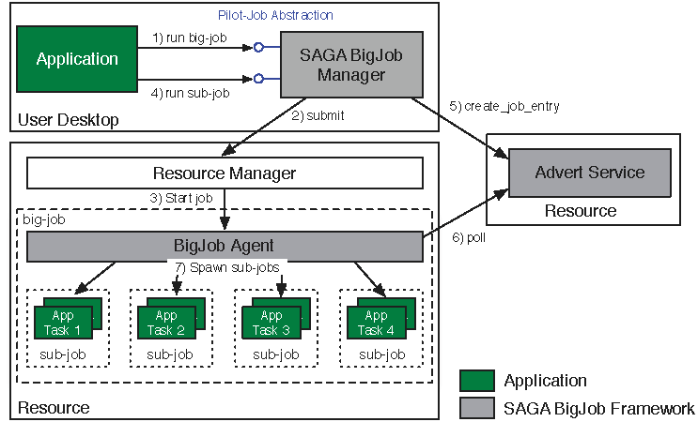
DARE Framework: A Solution Built upon SAGA-BigJob
SAGA (BigJob) : Abstractions for Dynamic Execution

Slide 21
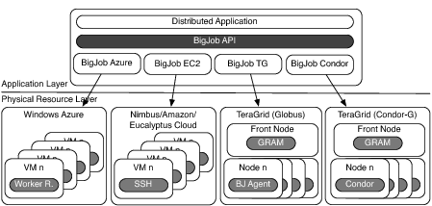
DARE Framework: A Solution Built upon SAGA-BigJob
SAGA (BigJob) : Infrastructure Independent Pilot-Job

Slide 22
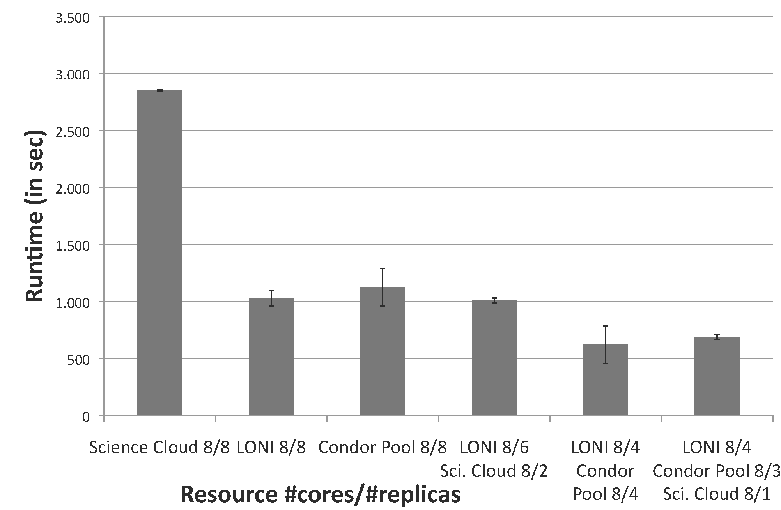
DARE Framework: A Solution Built upon SAGA-BigJob
SAGA (BigJob) : Infrastructure Independent Pilot-Job

Slide 23
DARE Framework: A Solution Built upon SAGA-BigJob
Frameworks: Logical structure for Capturing Application Requirements, Characteristics & Patterns
Pattern: Commonly recurring modes of computation
Programming, Deployment, Execution, Data-access..
Abstraction: Mechanism to support patterns and application characteristics
Frameworks designed to either:
Support Patterns: Map-Reduce, Master-Worker, Hierarchical Job-Submission
Provide the abstractions and/or support the requirements & characteristics of applications
i.e. Encode a Usage-Mode using a Framework

Slide 24
DARE Framework: A Solution Built upon SAGA-BigJob
DARE-Rfold : RNA structure
http://dare.cct.lsu.edu/dare-rfold
DARE-Dock : Docking
http://dare.cct.lsu.edu/dare-dock
DARE-HTHP : MD sim.
http://dare.cct.lsu.edu/dare-hthp
DARE-NGS :
http://dare.cct.lsu.edu/dare-ngs
Notes:
Need to use an

Slide 25
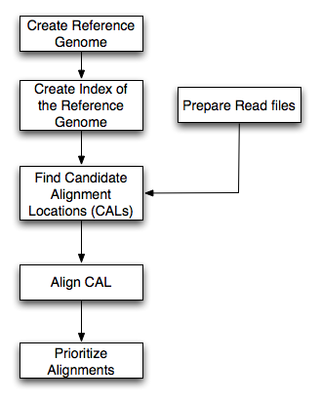
DARE-NGS : Mapping on Scalable Distributed HPC resources
BFAST
Higher sensitivity (CAL finding and gapped Smith-Waterman alignment)
Relatively larger memory and disk space
Multi-threading support
Low-memory option (index file splitting)
Pipeline (index, match, localalign, and postprocess step) and extensible (e.g. BFAST-BWA for paired-end, and more)
Task Level concurrency (Data fragmentation of Reads and Chromosomes, different spaced seeds (match step), parallel task runs (localalign, postprocess steps)
Workflow for bfast match step
Ref. Genome
Mapping
(Bfast)
SNP finding
NGS short reads

Slide 26
DARE-NGS : Mapping on Scalable Distributed HPC resources
Human Genome (HG18) and Burkerholderia Glumae :Prokaryote vs. Eukaryote
 |  | B. Glumae | Human Genome | Human- Chr 21
Genome Size |  | 7 Mbp | 2.8Gbp (hg18) | 47 Mbp (hg18-chr21)
NGS Type |  | Whole Genome | Exome | Exome
NGS Data Size |  | 12.6 GB | 5.6 GB | 5.6 GB
Ref. Index Data | 40 index files^{b)} | 40 GB | 130 GB | 70 GB
 | 10 index files
Minimum Memory^{b)} | 40 index files | 38/4 MB + α^{c)} | 3 GB + α | 164/4 MB + α
 | 10 index files | 38 MB + α | 12 GB + α | 164 ΜΒ + α
Two options generating 40 index files and 10 index files are considered
The cases with 10 index files. The option generating 40 index files require ¼ memory but needs 4 time computation
Data volume of a read file

Slide 27
Distributed Computing: Solution or Complexity?
Task Level Concurrency and Scale-Out
Compute System | # of cores | # of tasks | Task Concurrency | Bfast (mapping)
Workstation | 4 | 8 | No | ≈18 h
Ranger | 64 | 4 | Yes | 6.5 h
Ranger | 128 | 8 | Yes | 3.4 h
Ranger | 256 | 16 | Yes | 1.95 h
Case | HPC System | # of cores | Bfast (mapping)
I | QB | 256 | 2.66 h
II | Ranger | 128 | 2.11 h
 | QB | 128
Read Data
(12 GB)
Reference Genome
I
II
Notes:
(JK) Here, upper two tables represent the benefits of task level concurrency and scale-out strategy

Slide 28
DARE-NGS : Mapping on Scalable Distributed HPC resources
Time to Completion (Match Step) vs. Short Read File Size
HG18
HG18-Chr21
B.Glumae
Time to Completion (Match Step) vs. Num. of Threads

Slide 29
DARE-NGS : Mapping on Scalable Distributed HPC resources
The Importance of Dynamic execution utilizing the information about target species, NGS protocol, multi-core, cluster environment, disk space, memory, and available task level parallelism
Single Machine
HPC cluster with BigJob
Case | Read File Size(GB) | # of Task | Threads/task | Bfast (Mapping)
s1 | 2.4 | 1 | 4 | 2.6
s2 | 1.2 | 2 | 2 | 1.5
s3 | 0.6 | 4 | 1 | 2.5
s4 | 0.6 | 4 | 4 | 1.6
Case | Read File Size (GB) | # of Task | BigJob size | Bfast (Mapping)
g1 | 0.21 | 40 | 80 | 1.1
g2 | 0.44 | 20 | 40 | 2.2
g3 | 0.21 | 40 | 12 | 7.2
g4 | 0.44 | 20 | 12 | 6.6
Notes:
This will be very hard to read!

Slide 30
Summary
DARE framework and DARE-NGS
Non-invasive runtime environment for life science applications
Lightweight, extensible, and full-fledge gateway framework
SAGA/BigJob (distributed, scale-out, and extensible for large scale distributed data)
Challenges and Ongoing investigation
Distributed data management
Data transfer of Reference genome index files : HG18 : 130 GB, B.Glumae :447 MB
Data transfer of Short read files : e.g. 9 GB (about 2 min from local to QB using GridFTP)
Data Transfer (130 GB)
protocol | Local -> QB | Local -> Ranger | QB -> Ranger
SCP | 33 MB/s (1 h) | 1.8 MB/s (20 h) | 1 MB/s (36 h)
GridFTP | 70 MB/s (0.5 h) | 6.8 MB/s (5.3 h) | 25 MB/s (1.4 h)
Interoperability between grids and clouds
HPC-HTC : EGEE-TG[-NAREGI] / HPC-HTC, KEK/NAREGI-TG /HPC-HTC, ExTENCI [TG-OSG] /HPC-HPC, TG-DEISA
HPC-Cloud
GANGA/DIANE integration

Slide 31
What’s next?
Influx of challenges with large data volume and with new protocols and new applications in high-throughput DNA sequencing
Name | Key Features | Color Space | Memory/Diskspace | Strength | Weakness
BFAST | Multiple spaced seeds, Suffix Array, Full Smith-Waterman, low memory option with 4 time slowing down | Yes | d = 0 : 16 G/130 GB d = 1 : 4 G / | High Sensitivity | Requiring large disk space and large memory
BWA | Burrow-Wheeler Transform, Smith-Waterman (BWA-SW) | Yes (?) |  | Faster than BFAST | Hang without an error message, Medium sensitivity
Bowtie | Memory efficient, only ungapped alignment |  |  | Very fast and low memory | Low sensitivity
SHRiMP2 | SSE2 support, OpenMP support. Low memory option with 2-3 time slowing down | Yes | K = 4 : 48 G K = 3 : 4 G | High Sensitivity | Large memory requirement
SSAHA2 |  |  |  | Simple to use | Not actively updated
SOAP2
Novoalign | Full Needleman-Wunsch, up to 8 or more mismatches per read, up to 16 on paired end reads, Illumina oriented, commercial |  |  |  | Commercial software

Slide 32
What’s next?
Example of difficulty of scientific discovery with NGS data analytics
Different results of Genome Variation (SNP, small Indel) study
App. | Type | # of SNPs | # of small indels | Mapped reads (mapping %) | # of Reads (File Size)
BFAST | Single End | 130,980 | 42,798 | 27,571, 194 (70.32 %) | 39,206,572 (4.7 G)
 | Paired-end
BWA | Single End | 36,122 | 2,011 | 18,324,681 (46.74 %) | 39,206,572 (5.2 G)
 | Paired-end | 36,343 | 3,273 | 26,254,061 (33.48 %) | 78,413,144 (5.2 G, 4.3 G)

Slide 33
What’s next?
Extension of DARE-NGS & DARE framework
Distributed data management (File transfer service, Pilot store, Hadoop/MapReduce, …)
Workflow support (Shorten cycles for development, enhancement, and optimization) – exponential increase in the number of types of services with combinatorial nature in pipelines for NGS data analytics
Ref. Genome
Mapping
(App A)
SNP finding
(App B)
NGS short reads

Slide 34

Acknowledgements
SAGA Team and DPA Team and the UK-EPSRC
(UK EPSRC: DPA, OMII-UK , OMII-UK PAL)
People
SAGA D&D: Hartmut Kaiser, Ole Weidner, Andre Merzky, Lukasz Lacinski, João Abecasis, Chris Miceli, Bety Rodriguez-Milla
SAGA Users: Andre Luckow, Yaakoub el-Khamra, Kate Stamou, Cybertools (Abhinav Thota, Jeff, N. Kim), Owain Kenway
Google SoC: Michael Miceli, Saurabh Sehgal, Miklos Erdelyi
Collaborators and Contributors: Steve Fisher & Group, Sylvain Renaud (JSAGA), Go Iwai & Yoshiyuki Watase (KEK)
DPA: Dan Katz, Murray Cole, Manish Parashar, Omer Rana, Jon Weissman
Collaboration
Jong Hyun Ham (Plant Pathology and Crop Physiology, LSU) B. Glumae
Tuomo Rankinen (Human Genome Lab, PBRC) Human Exome
Genome Core Facility, PBRC
Support
Louisiana Biomedical Research Network (LBRN)

